Slide 1
Quantum & AGI Computing: Course Overview

Slide 2
Superposition & Entanglement
“Quantum computing” is an emerging approach that represents a significant departure from classical computing approaches.
This new form of computing is rooted in quantum mechanics, which focuses on the functioning of matter at lower scale levels, such as atoms and subatomic particles.
Unlike classical computing, quantum computing utilizes qubits, which differ from the standard bits used in electronic computers.

Slide 3
Superposition & Entanglement
While regular bits are 0 or 1, qubits can simultaneously exist in both states, a phenomenon know as superposition.
Superposition enables quantum computers to process vast information rapidly, making them significantly faster than conventional computers.
Another important aspect of quantum computing is quantum entanglement, where qubits become interconnected uniquely.
When two quantum objects are entangled, Altering one object causes a corresponding change in the other, regardless of the distance between them. This characteristic allows quantum computers to perform numerous calculations concurrently, a feat unattainable by regular computers

Slide 4
Artificial General Intelligence (AGI)
Quantum computing is one of the three main pillars of the Artificial General Intelligence (AGI).
AGI is the next wave of AI where intelligence is applied autonomously and flexibly as if the AI agent is a human being,
In AGI, agents are expected to act, behave and independently take decisions, without the interference or guidance from huma beings
The other two pillars are Agentic AI and blockchain.

Slide 5
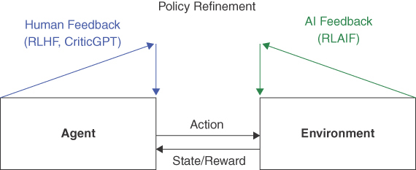
AI Agents
“AI Agents” is a new-old concept that refers to intelligent agents that interact with an environment or another intelligence sources to make decisions
A good example are the Reinforcement Learning agents which interact with environments to make intelligent decisions and solve problems
Recently, the term “AI Agents” got a new dimension, with ad advent of “Generative AI Agents”, where the intelligent agents interact with LLM generative systems to solve problems and provide answers

Slide 6
Agentic AI
The success of AI Agents in Generative AI Chatbots led to the mergence of a new filed: Agentic AI
In agentic AI, Autonomous AI agents are designed and implemented using emerging platforms such Langchain, AuoGen, Crew.
An AI agent is a computational system that perceives its environment, processes internal state, and takes actions to achieve defined goals.
These systems exhibit autonomy, adaptability, and reactivity—key attributes that differentiate them from traditional software programs.
An agent operates not merely by reacting to inputs, but by maintaining context, managing goals, and adjusting strategies based on feedback.
This dynamic behavior draws from the paradigm of situated AI, where intelligence emerges from continuous interaction with the environment. “

Slide 7
Blockchain Technologies
Since their emergence in 2008, Blockchain system technologies became the Defacto approach for building secure, decentralized, reliable and resilient systems
At some stage they became known as Web-3 or Value-Web
Their role is providing trust in the anticipated Artificial General Intelligence

Slide 8
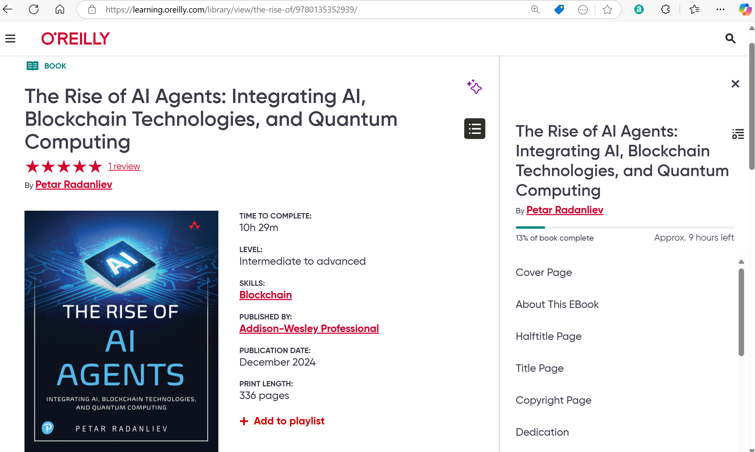
Reference One

Slide 9
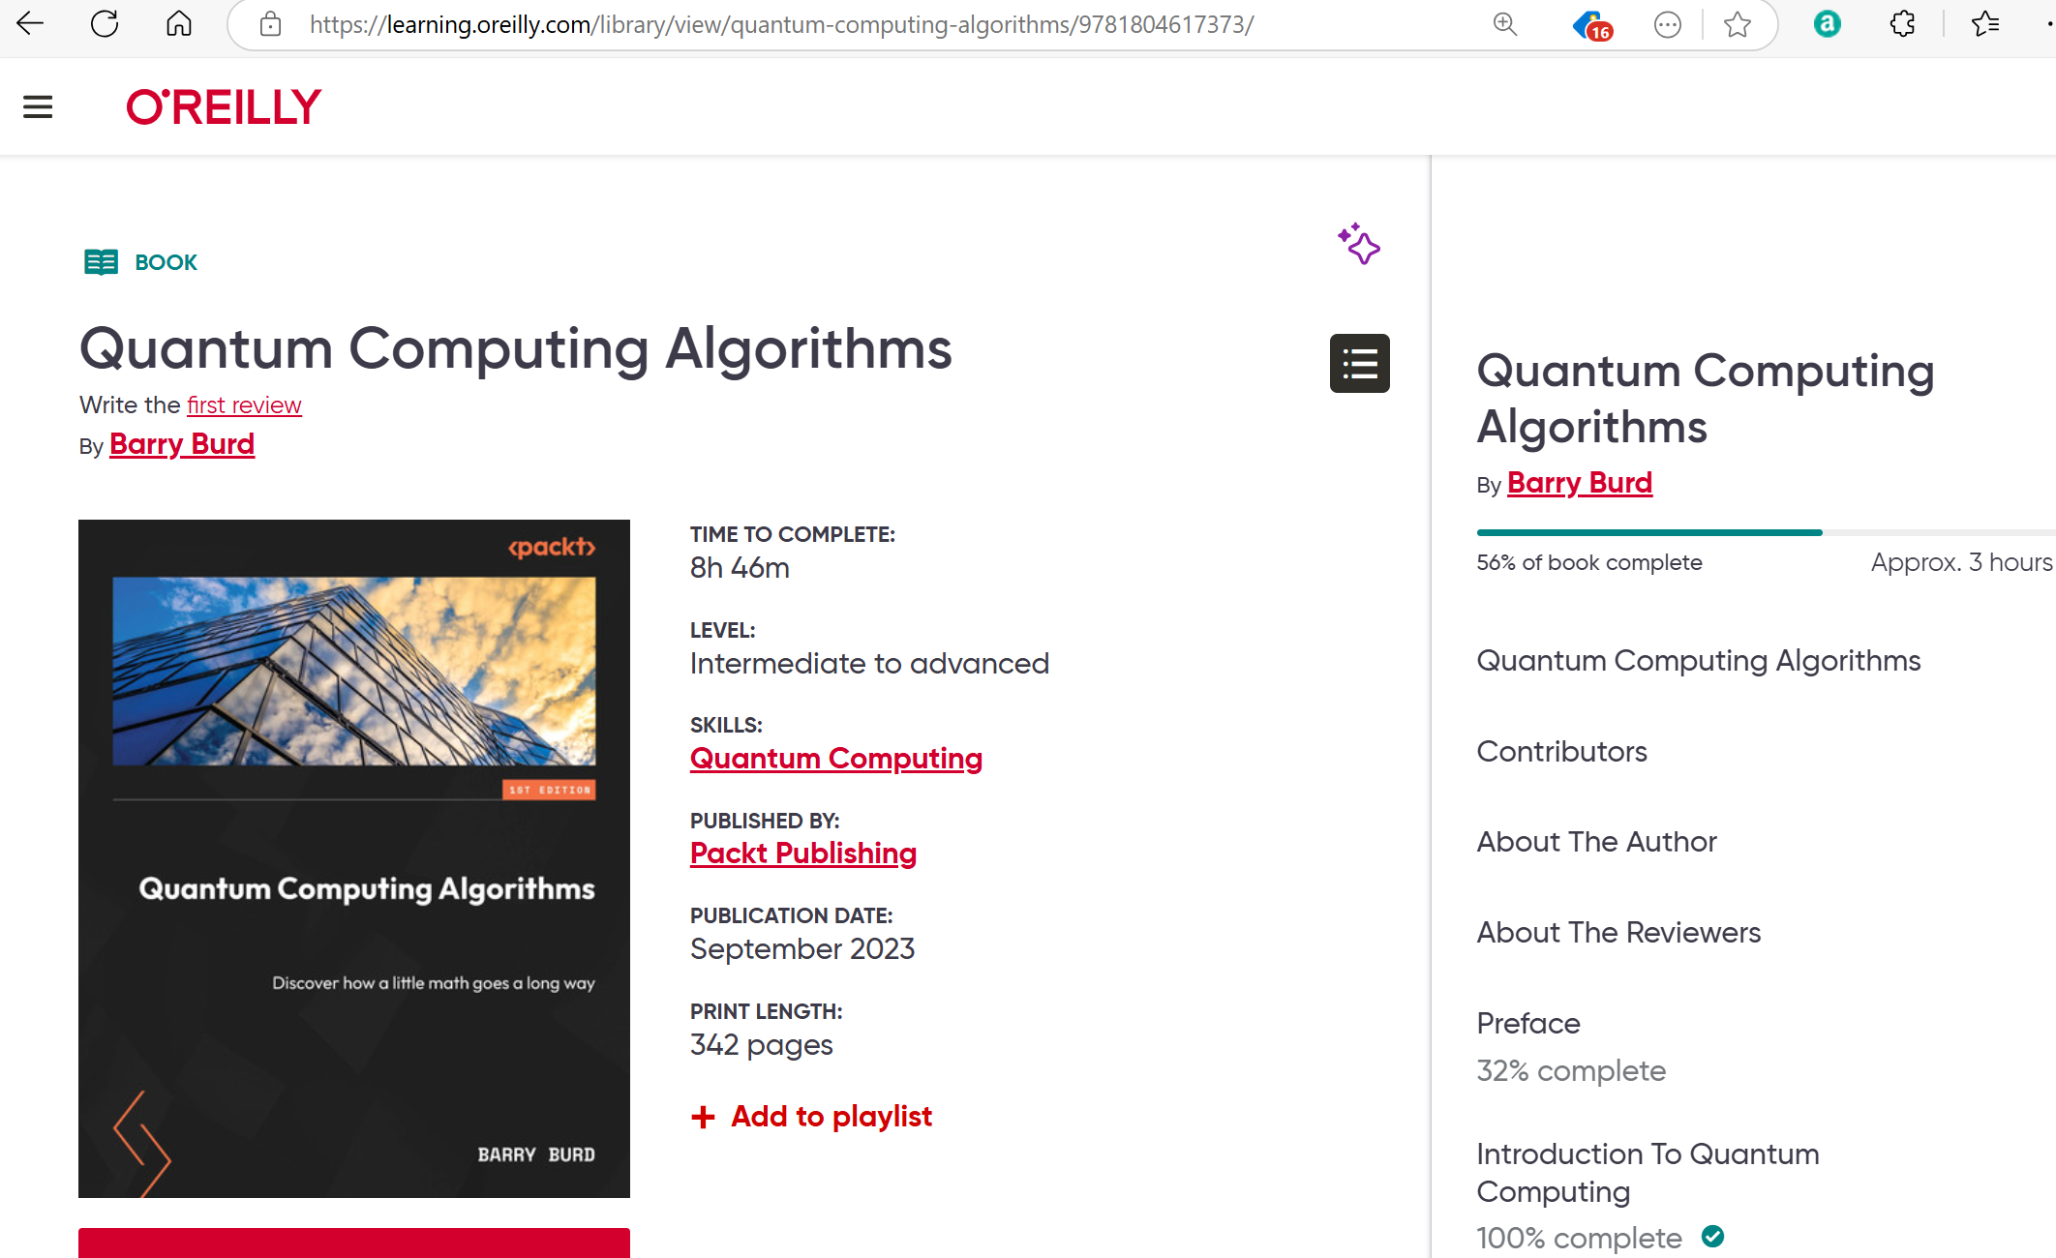
Quantum Computing Algorithms

